Slide 1
Final Presentation
Arpit Shah
Neha Pai
Nikita Bafna
Z534 Search
INDIANA UNIVERSITY BLOOMINGTON

Slide 2
Yelp Recommendation System
SECTION 1

Slide 3
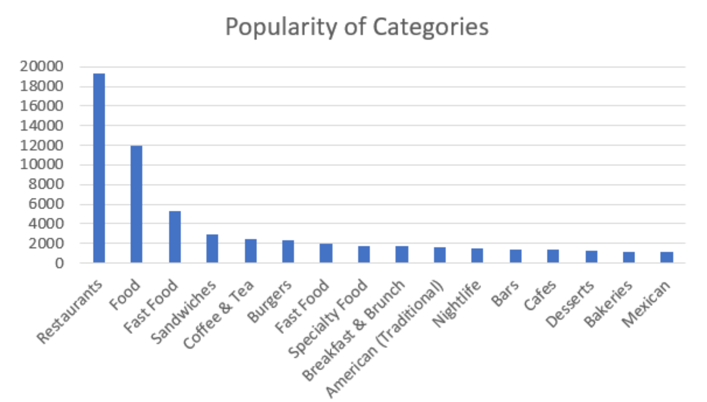
Yelp Recommendation System
Exploratory Data Analysis and Preparation
6685900 Reviews in Review.json
192609 Businesses in Business.json
1637138 Users in Users.json
Evaluating Businesses

Slide 4
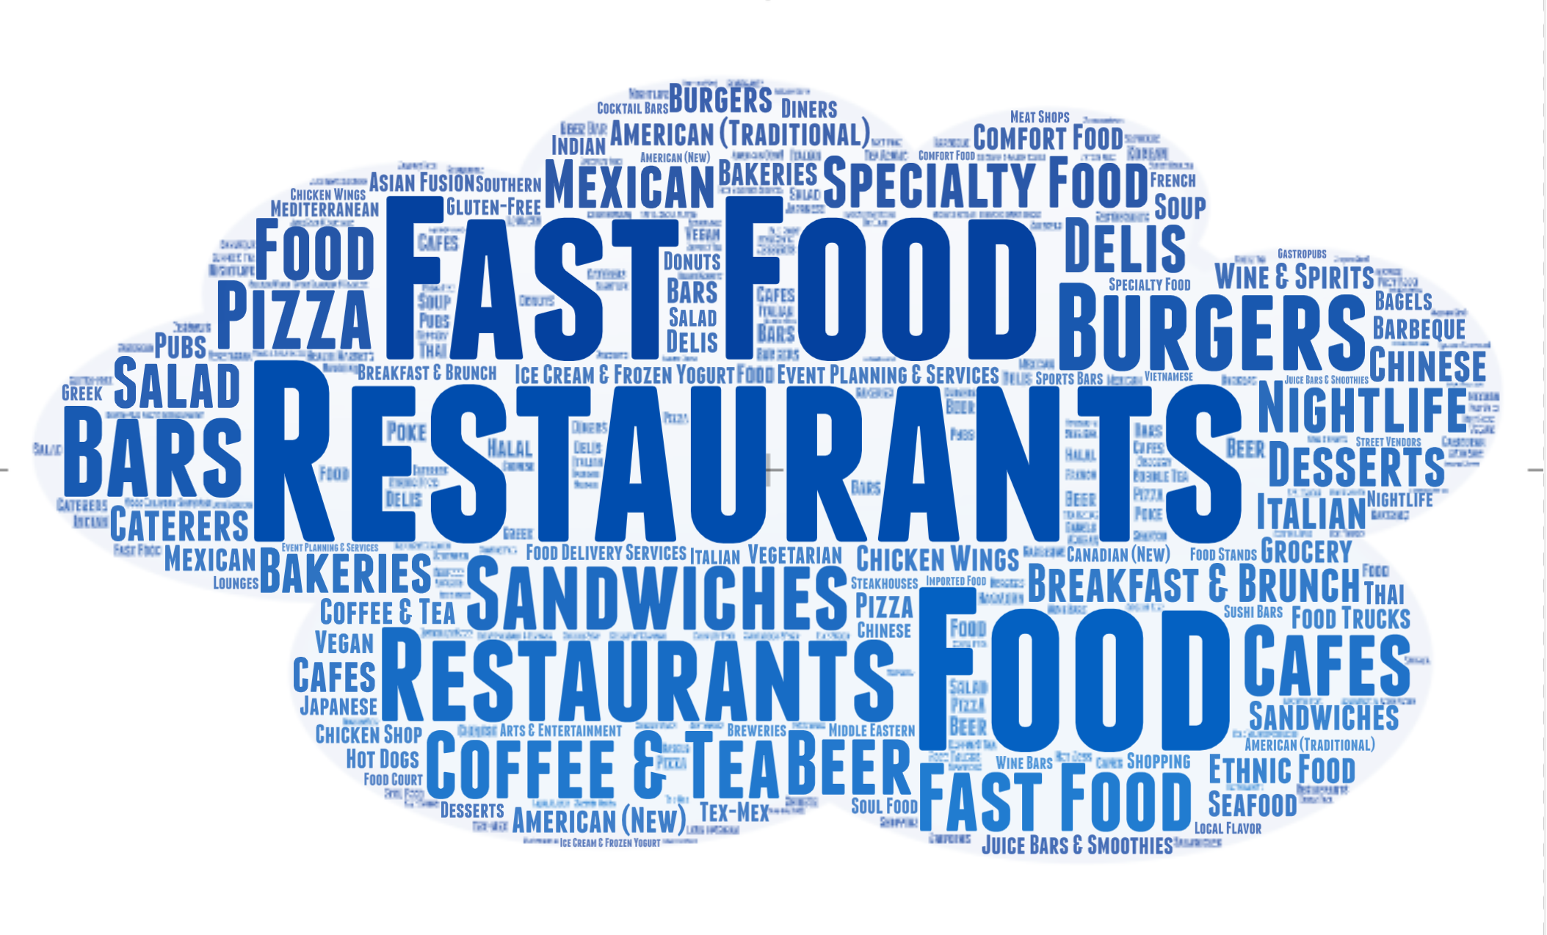

Slide 5
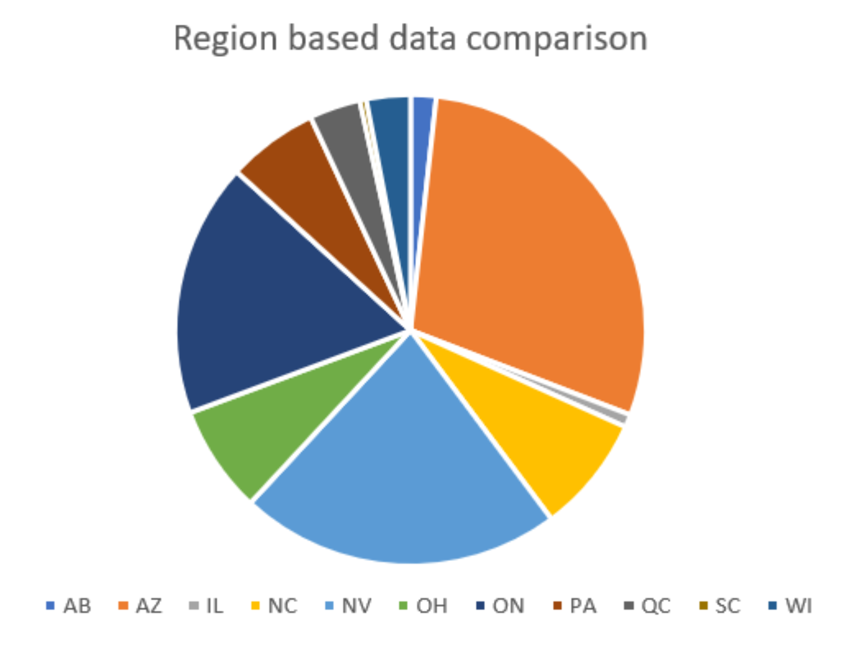
Yelp Recommendation System
Chose Food and Restaurants category
We consider only ‘OPEN’ restaurants
Have at least 50 reviews
Nevada State

Slide 6
Yelp Recommendation System
Tasks Covered
Collaborative filtering
Content based filtering
Hybrid approach recommendation
Similarity Calculation
Matrix formulation
Prediction
Recommendation
Evaluation

Slide 7
Recommendation models
Memory Based
User based : Measure the similarity between target users and other users.
Item based : Based on the similarity between the items that the target user rated.
Model Based
SVD Decomposition : Latent factor model to capture the similarity between users and items
Hybrid - Content Based + Collaborative

Slide 8
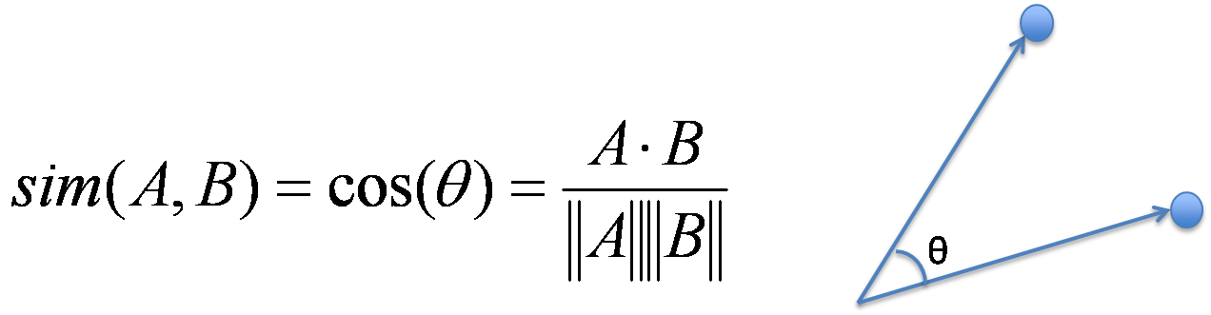
Similarity Calculation
Similarity Calculation
Used Cosine Similarity to calculate similarity between User-User and Item-Item

Slide 9
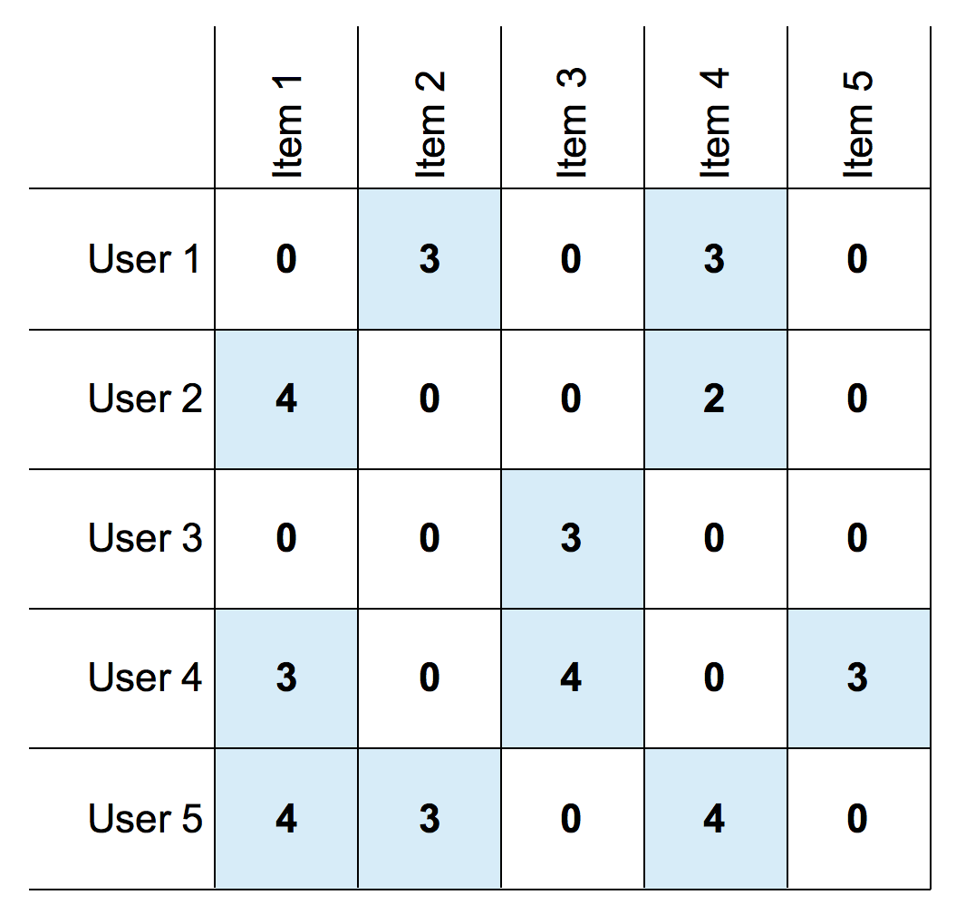
Matrix Formulation
Created matrix with user_id as rows, business_id as columns(item) and rating as value

Slide 10
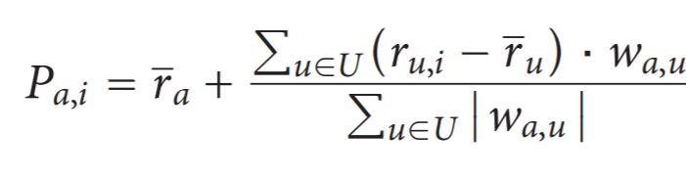
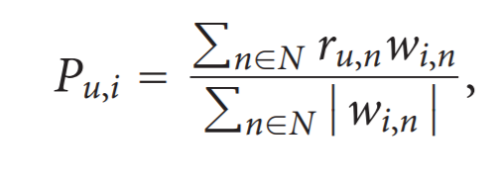
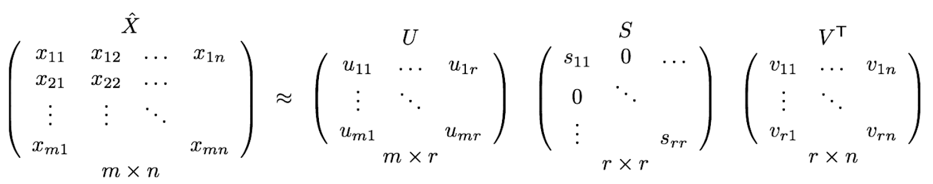
Prediction Formulae
User Based CF Model Item Based CF Model
Model Based : SVD Decomposition

Slide 11
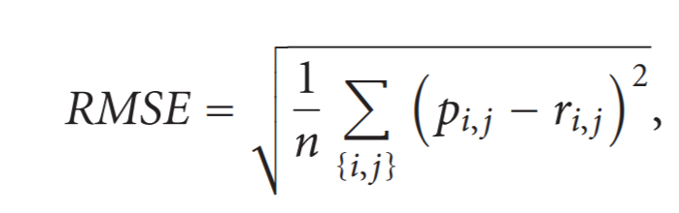
Evaluation
Root Mean Square Error: RMSE is just the square root of MSE. The square root is introduced to make scale of the errors to be the same as the scale of targets.
User-based Collaborative Filtering RMSE: 3.8441
Item-based Collaborative Filtering RMSE: 3.8460
Model based SVD RMSE : 3.8350

Slide 12
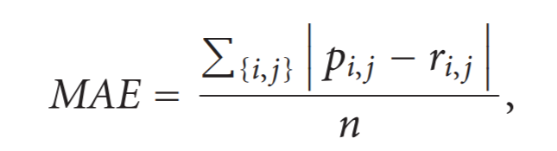
Evaluation
Mean Average Error : MAE computes the average of the absolute difference between the predictions and true ratings.
User-based Collaborative Filtering MAE: 3.8047
Item-based Collaborative Filtering MAE: 3.8068
Model based SVD MAE : 3.7831

Slide 13
Recommendation using Hybrid based model
Worked with textual information - Categories and Attributes data of Business.json file
Categories Picked : Food or Restaurant
Only picked attributes where the value is True
Nested attributes were concatenated with underscore(‘_’)
Combined Attributes and Categories
Category : ['Mexican', 'Restaurants', 'Patisserie/Cake Shop', 'Food', 'Bars', 'Nightlife']
Attribute : {'BikeParking': 'True', 'BusinessParking': {'garage': False, 'street': False, 'validated': False, 'lot': True, 'valet': False}
Combined_features: ['Mexican', 'Restaurants', 'Patisserie/Cake Shop', 'Food', 'Bars', 'Nightlife', 'BikeParking', 'BusinessParking_lot’]

Slide 14
Recommendation using Hybrid based model
Clustered businesses using K - means algorithm into 50 classes based on TF-IDF Vectorization on textual information created before.
Similar users clustered together.
Used these clusters to generate predicted ratings based on collaborative filtering.
Got better performance.
Evaluation:
Hybrid model RMSE: 3.6544
Hybrid model MAE: 3.6014

Slide 15
Review Keyphrase Extraction & Retrieval
SECTION 2

Slide 16
Problem Statement
Significance
Problem Statement
Extracting relevant key phrases from reviews of businesses
Indexation and Retrieval of Business Reviews based on selected tags
Extract User interested in certain features associated with businesses
User may want to read reviews related to specific features

Slide 17
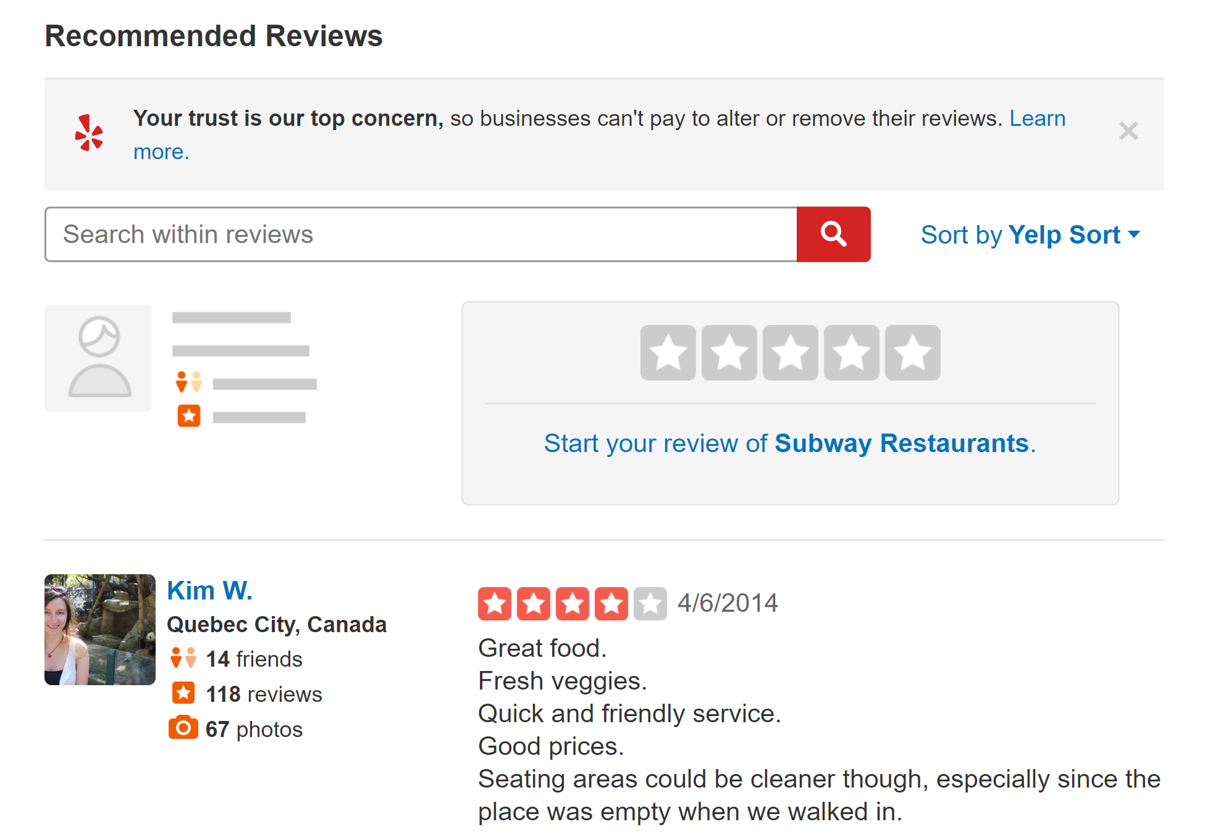
Yelp current system
Current System
User cannot view popular review phrases and use it to extract reviews of his choice
Only option to search tags and retrieve reviews

Slide 18
Review Keyphrase Extraction
SECTION 2.1

Slide 19
Current Work on Keyphrase Extraction
Current Work
RAKE (Rapid Automatic Keyword Extraction)
Simple Statistical Approach
Uses a list of stopwords and phrase delimiters to detect the most relevant words or phrases in a piece of text.
PKE
End-to-end keyphrase extraction pipeline
TF-IDF Based
Graph Based Approaches

Slide 20
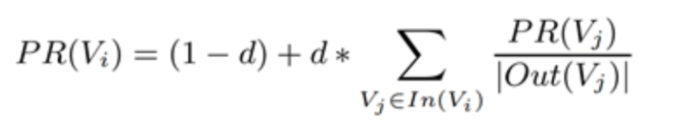
Our Approach
Our Approach
Extend PageRank Based Text Summarization learnt in class
Represent Document as a network whose nodes are candidate keyphrases
Find a score that is associated with each vertex, which represents the “importance” or “power” of that vertex within the graph.
Unsupervised Method

Slide 21
Data Preprocessing on Reviews
Data Preprocessing
Let’s Focus of Restaurants of Nevada State
We will focus on 15 Businesses with >50 reviews
Lemmatizing words
Converting string into lower case
Removing stop words
Removing special characters and numbers

Slide 22
Getting Started with code!
Problem Statement
Used N-gram based approach
Generated Unigrams, Bi-grams, Tri-grams to generate Graph Nodes
Used networkx package to build graph
Score nodes using default pagerank algorithm
Graph generated for every business using all reviews
Importance Scores Computed
Extract most popular Tags

Slide 23
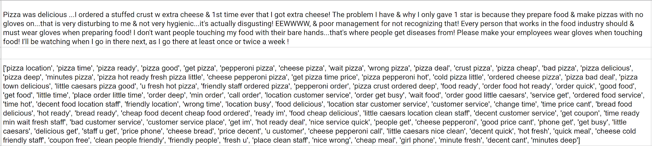
Sample Generated Tags

Slide 24


Evaluation
Problem Statement
ROUGE - Recall-Oriented Understudy for Gisting Evaluation
A set of metrics for evaluating automatic summarization of texts as well as machine translations

Slide 25
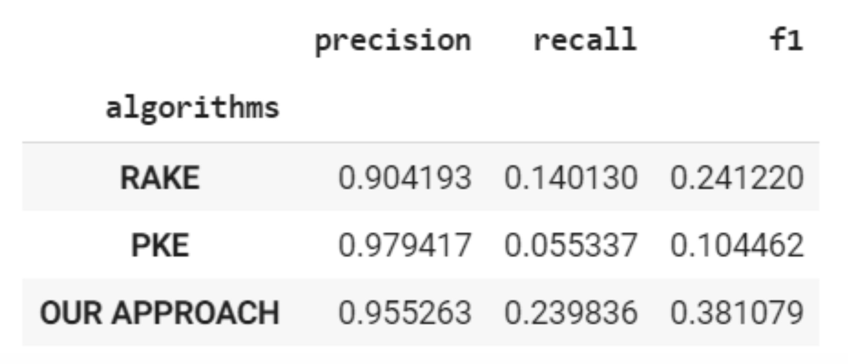
Evaluation

Slide 26
Indexation and Retrieval of Relevant Reviews
SECTION 2.2

Slide 27
Motive
Given the most popular tags, allow user to select tags and extract relevant reviews using information retrieval

Slide 28
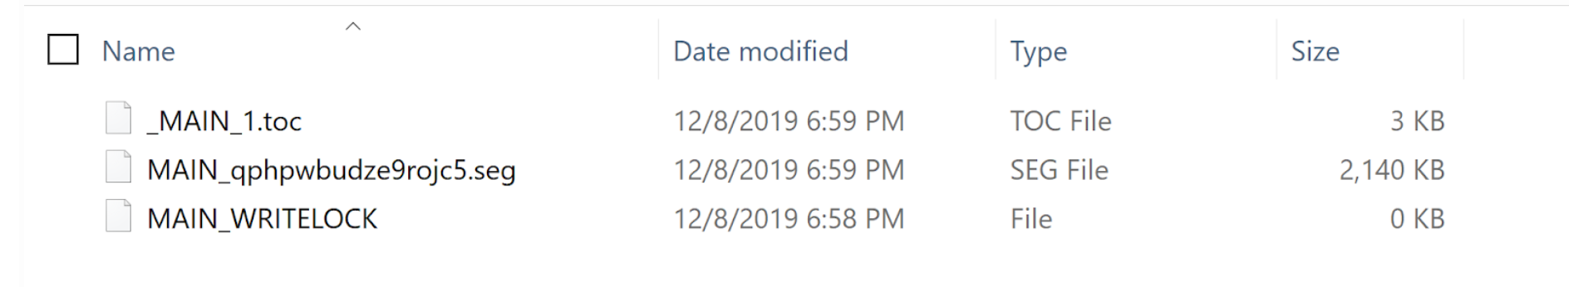
Indexation using Whoosh
Code!
Fast, pure-Python full text indexing, search, and spell checking library.
Pythonic API
Fielded indexing and search
Fast indexing and retrieval
We indexed - Business_id | User_id | Review | Business_name | Date | Username | Review_id

Slide 29
Retrieval
Code!
Implemented the BM25F scoring algorithm using Whoosh Searcher
BM25 - Bag-of-words retrieval function that ranks a set of documents based on the query terms appearing in each document
Used Whoosh QueryParser to parse Reviews
Retrieved top Search results

Slide 30
Tools Used
Python
Whoosh
Flask
Bootstrap

Slide 31
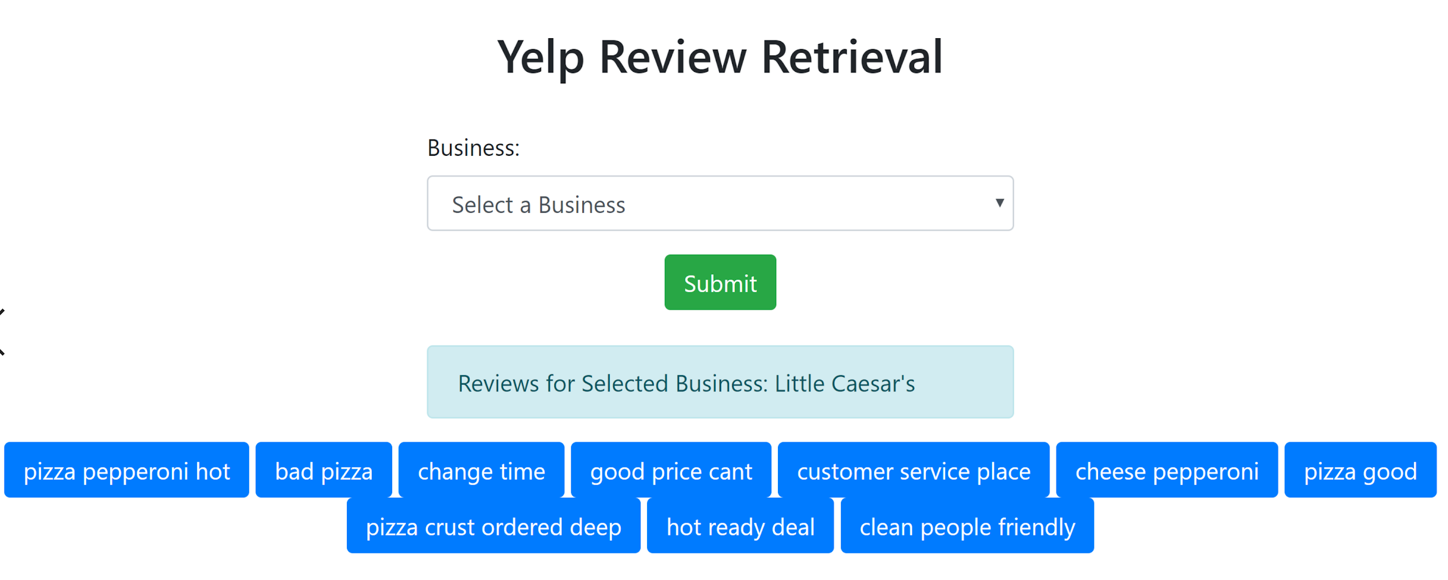

Slide 32
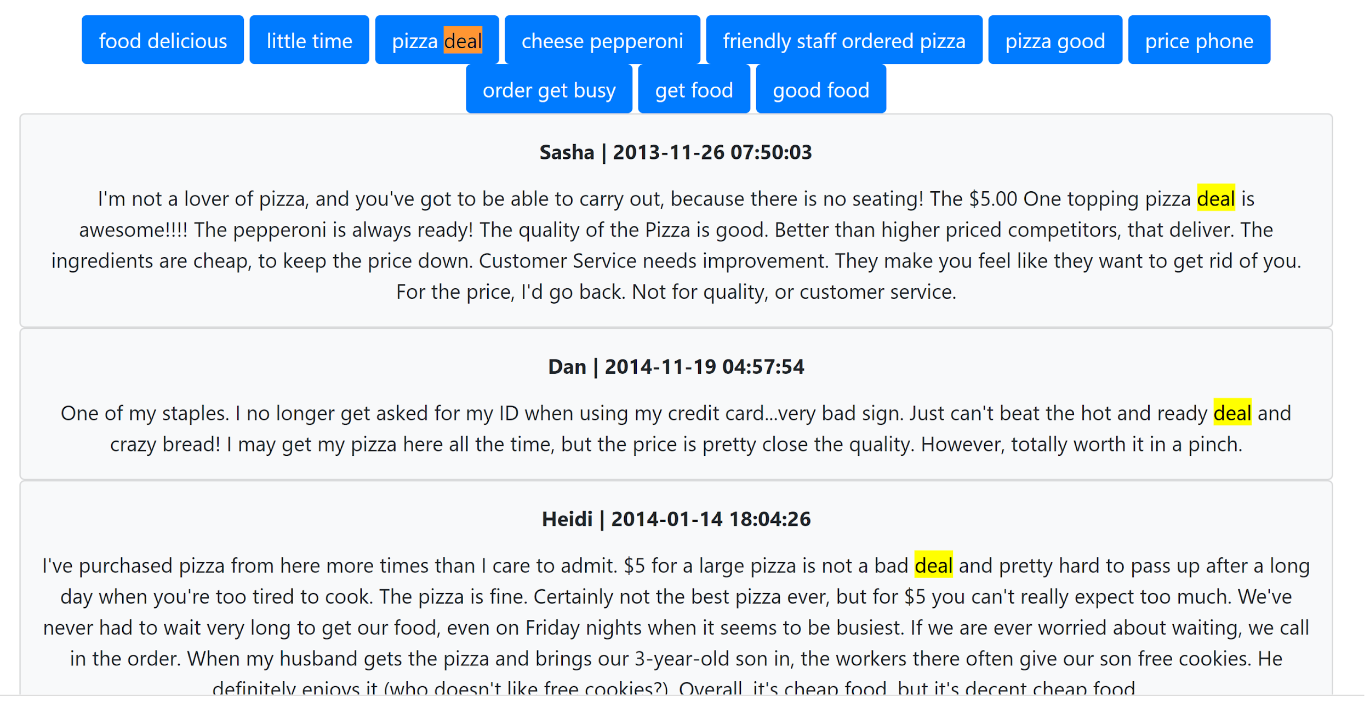

Slide 33
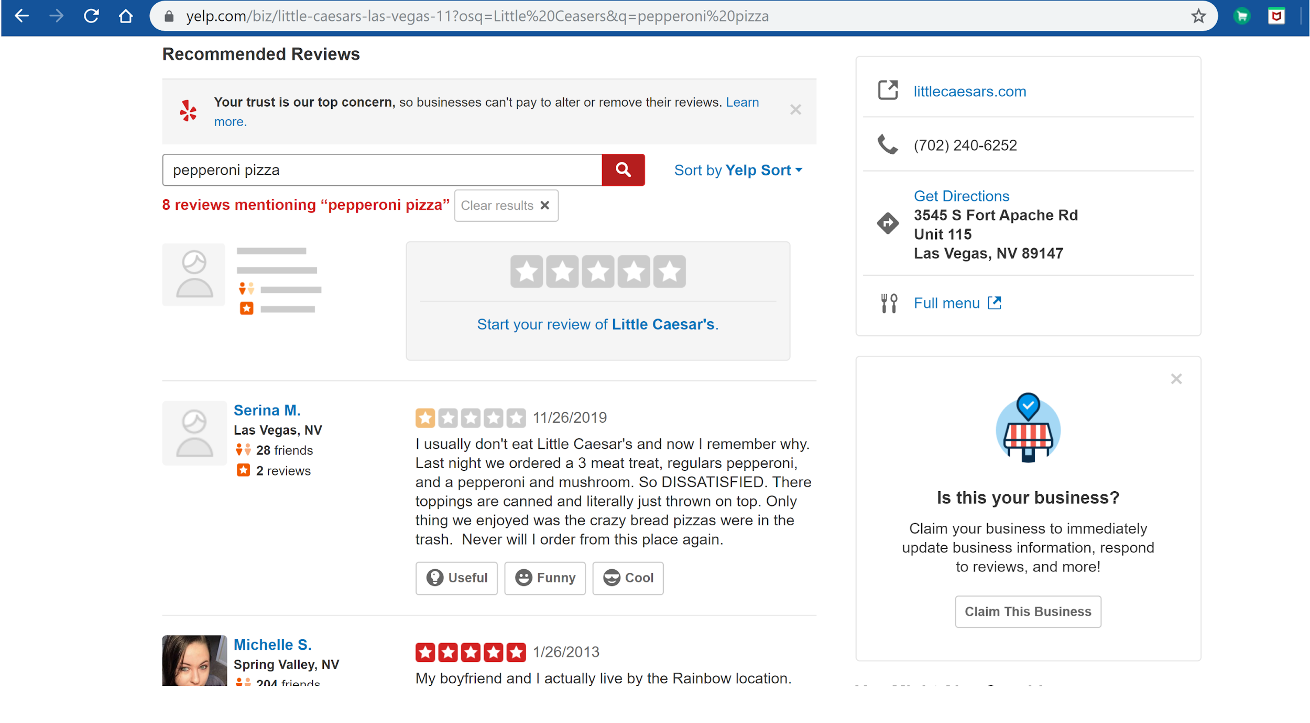
Evaluation
Difficult to evaluate retrieval
Many Reviews
Long Texts

Slide 34
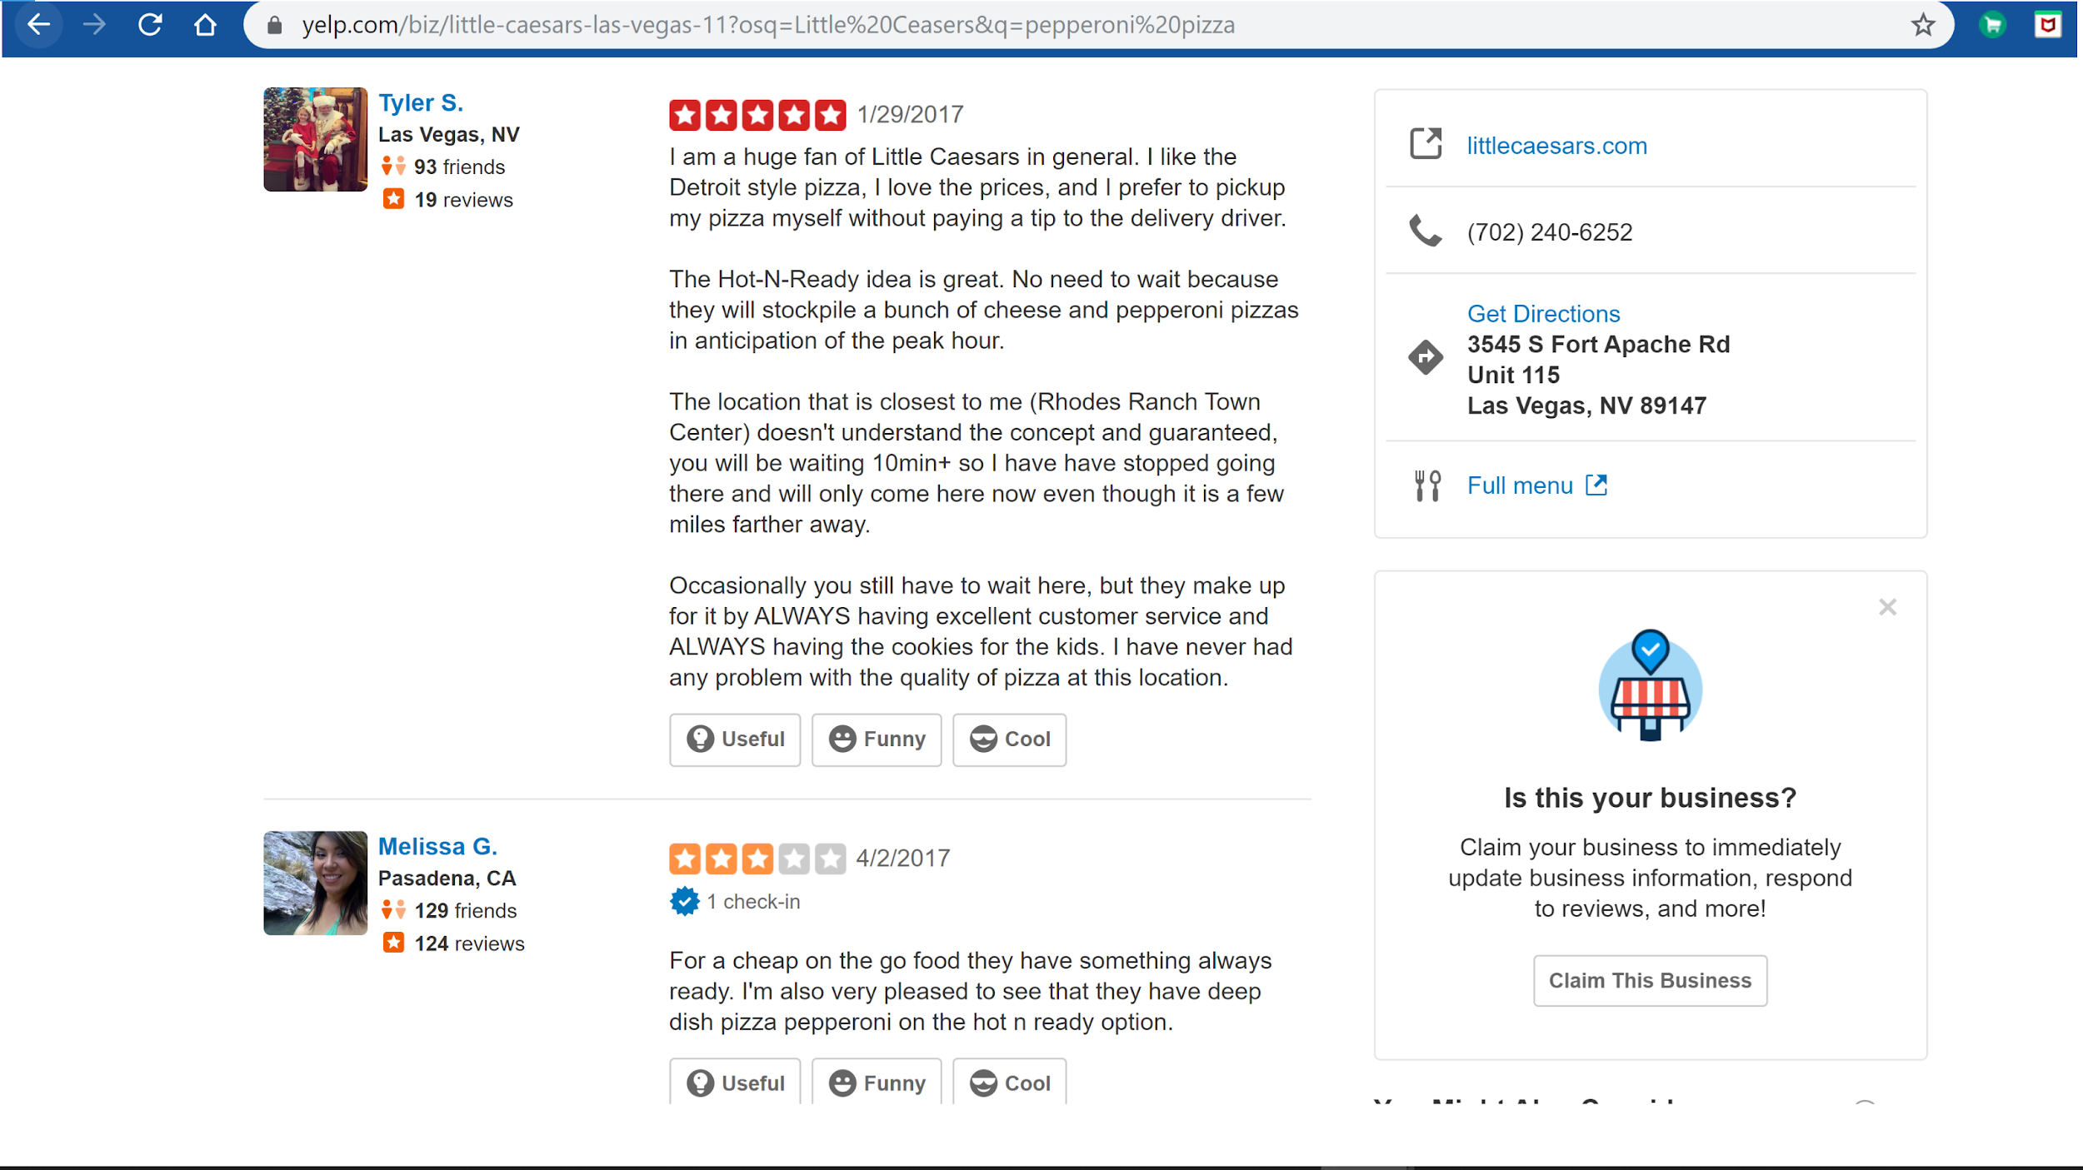

Slide 35
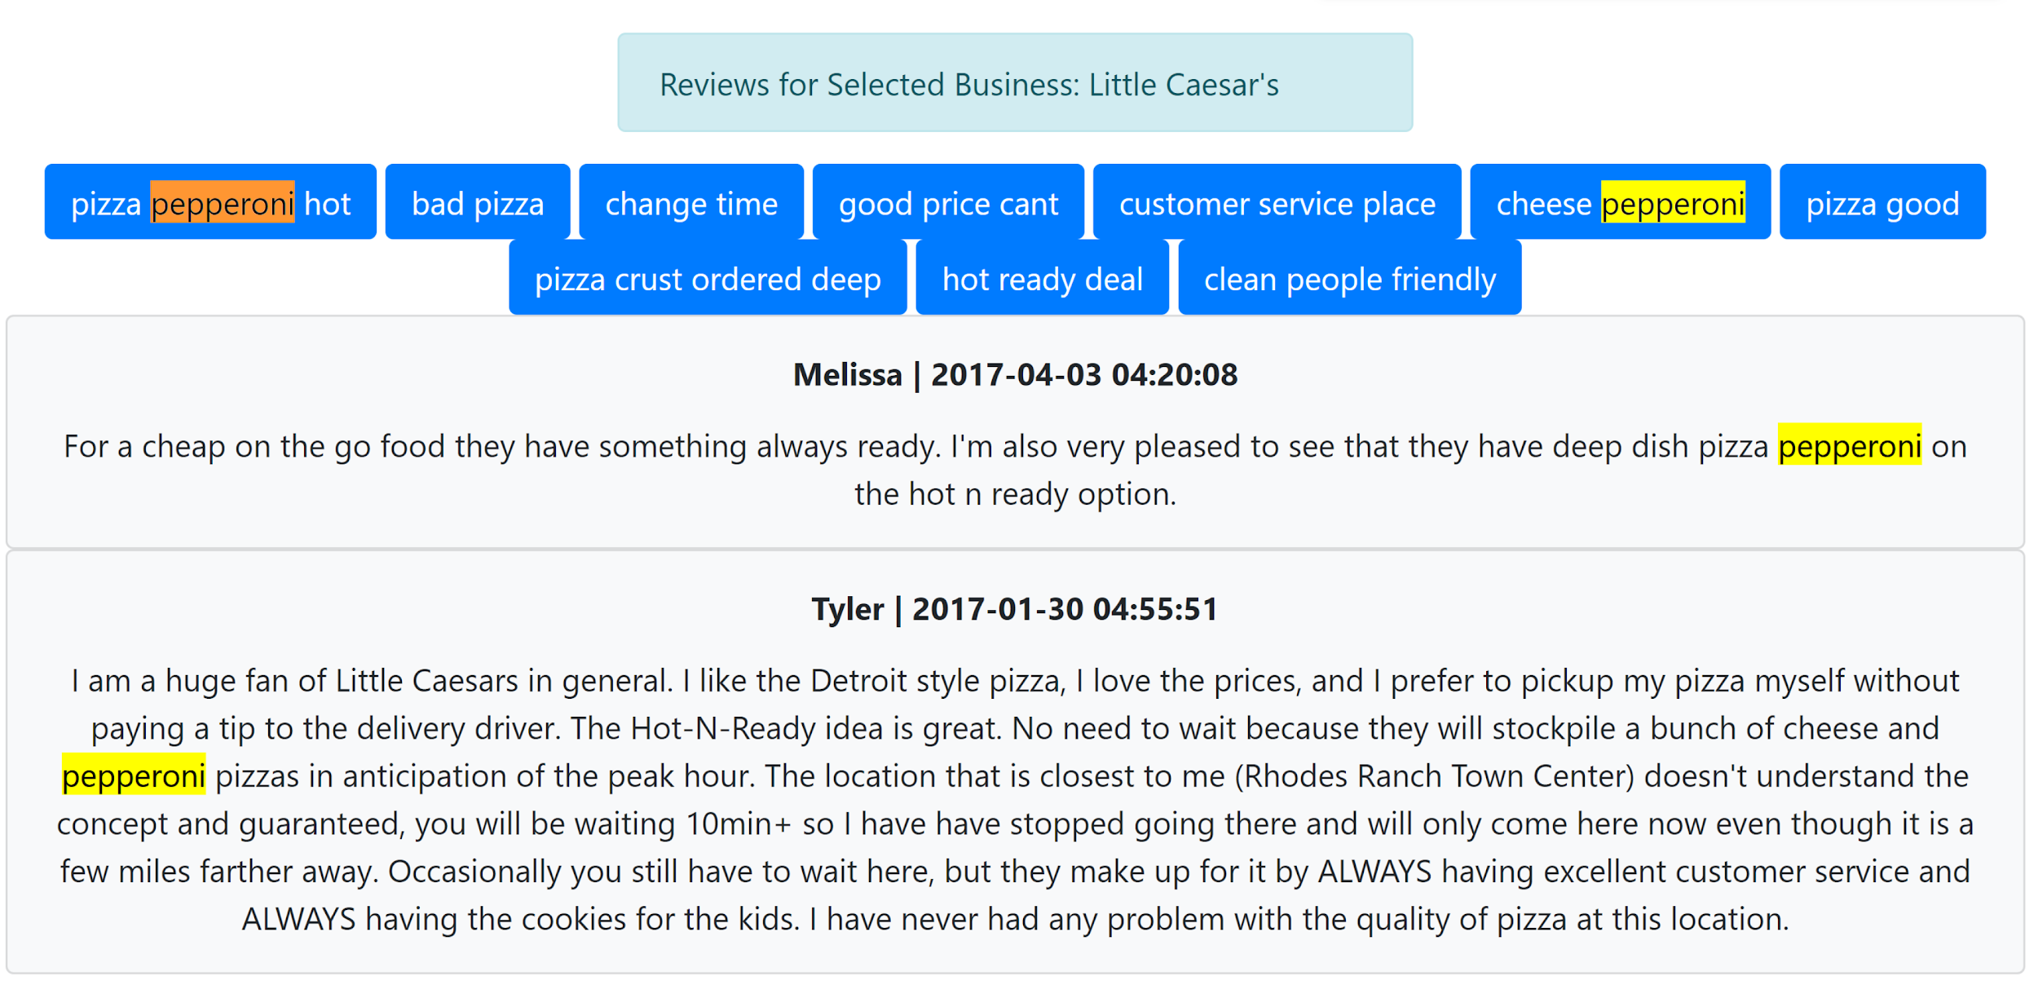

Slide 36
Thank you

